Slide 1

Implementation of A* Motion Planning in ROS 2 for Obstacle Avoidance in a 2D Occupancy Grid
Mohamed Eljahmi
RBE 550: Motion Planning
Worcester Polytechnic Institute (WPI)
Fall 2025

Slide 2
Motivation and Problem
Motion planning is essential for safe, efficient robot navigation
Applications: warehouses, aerial robotics, surgical robots
Motivating scenario: warehouse robot navigating shelves
Challenge: Efficient, collision-free path planning on 2D occupancy grids

Slide 3
Background: Graph-Based Search Methods
Classical search methods like Breadth-First Search and Depth-First Search are complete but very inefficient in large spaces.
Dijkstra’s algorithm improves this by assigning costs to edges and always expanding the lowest-cost node. This guarantees an optimal path, but it still explores in all directions, which can waste time.
A* builds on Dijkstra by adding a heuristic. The heuristic guides the search toward the goal, making it much faster while still giving an optimal path if the heuristic is admissible.
This diagram shows the key difference — Dijkstra expands evenly everywhere, while A* focuses the search in the direction of the goal.

Slide 4
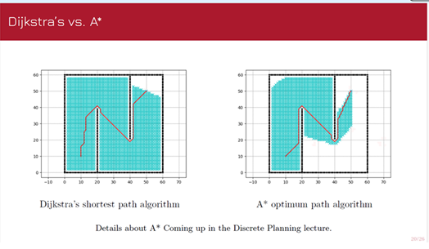
Visual Comparison between A* and Dijkstra
As shown in the diagram, Dijkstra expands evenly everywhere, while A-star focuses more in the direction of the goal.

Slide 5
Origin of the Algorithms
Dijkstra’s algorithm was invented in 1956 by Edsger W. Dijkstra, a Dutch scientist. He came up with it during a trip in Amsterdam, while thinking about how to find the shortest routes. Later, in 1968, Hart, Nilsson, and Raphael created A star at SRI International. They extended Dijkstra’s work by adding heuristics, which made the algorithm much more efficient for guiding searches toward the goal

Slide 6
Proposed Methods
Framework in ROS 2 : modular node-based design
Algorithm: A* (baseline) with configurable heuristics
Inputs: occupancy grid (/map), start and goal poses
Outputs: planned path (/planned_path), visualization in RViz
Planned Figure: occupancy grid + computed path (to be added later)

Slide 7
Goals and Evaluation
Path Planning: Compute collision-free paths using A*
ROS 2 Integration: Use standard message types
Visualization: RViz display (occupancy grid,
path, search expansion)
Evaluation Metrics:
Path length
Nodes expanded
Computation time
Extensions: BFS, DFS, Dijkstra, real hardware tests

Slide 8
Schedule and Expected Results
Weeks 1–2: Literature review, ROS 2 setup
Weeks 3–4: A* implementation (not started yet)
Weeks 5–7: ROS 2 integration, testing
Weeks 8–9: Evaluation (synthetic environments)
Week 10: Results, video, final report
Expected outcome: reproducible ROS 2 package, clear visualization of A*

